Slide 1

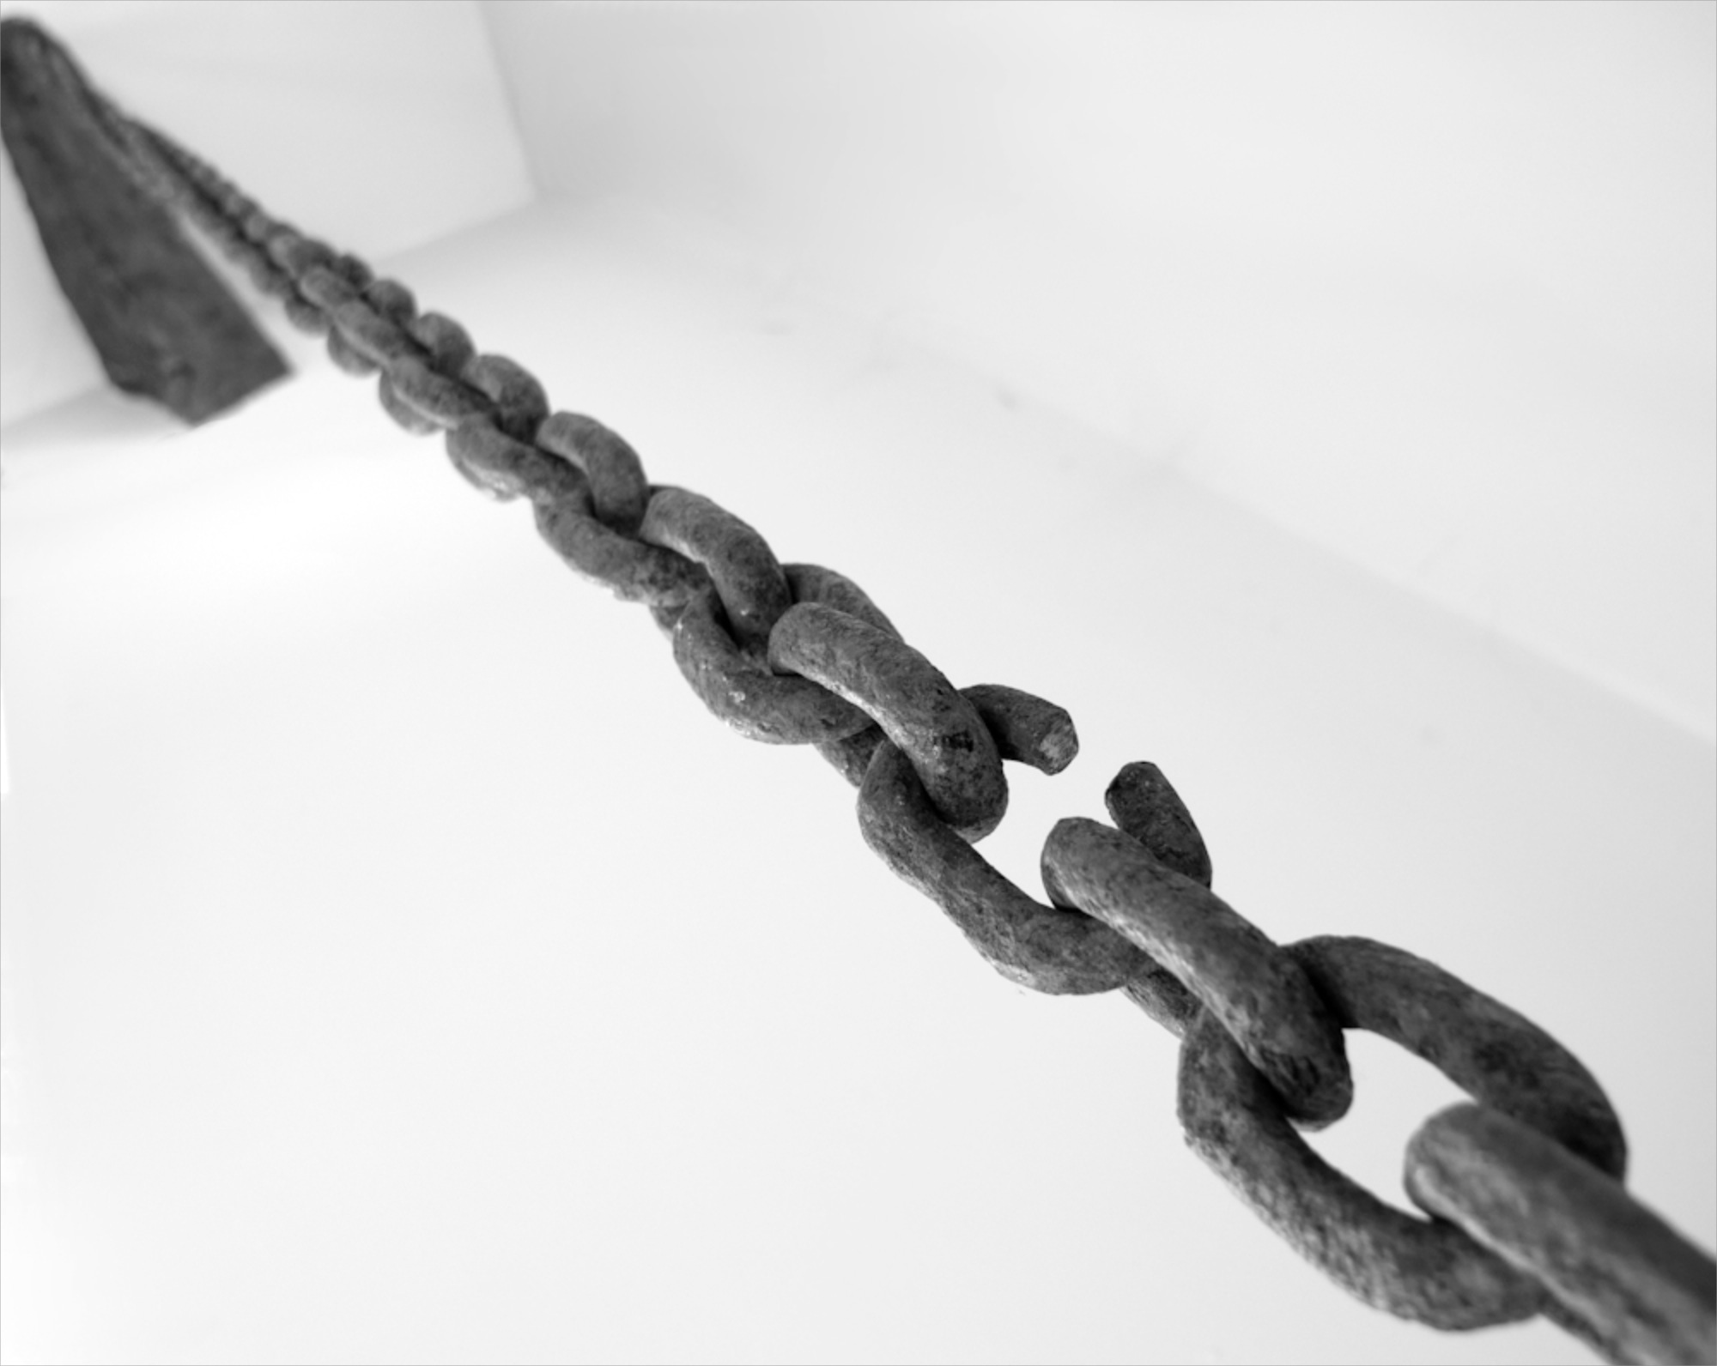

National Aeronautics and Space Administration
NASA CARBON MONITORING SYSTEM (CMS)
CAPABILITY RISK
WORKING GROUP
JOSHUA B. FISHER (JPL)
COORDINATOR
ROBERT KEY (PRINCETON); GEORGE HURTT (UMD)
MEMBERS
cms_wg_risk@cce.nasa.gov
National Aeronautics and Space Administration
Jet Propulsion Laboratory
California Institute of Technology
Pasadena, California
www.nasa.gov

Slide 2
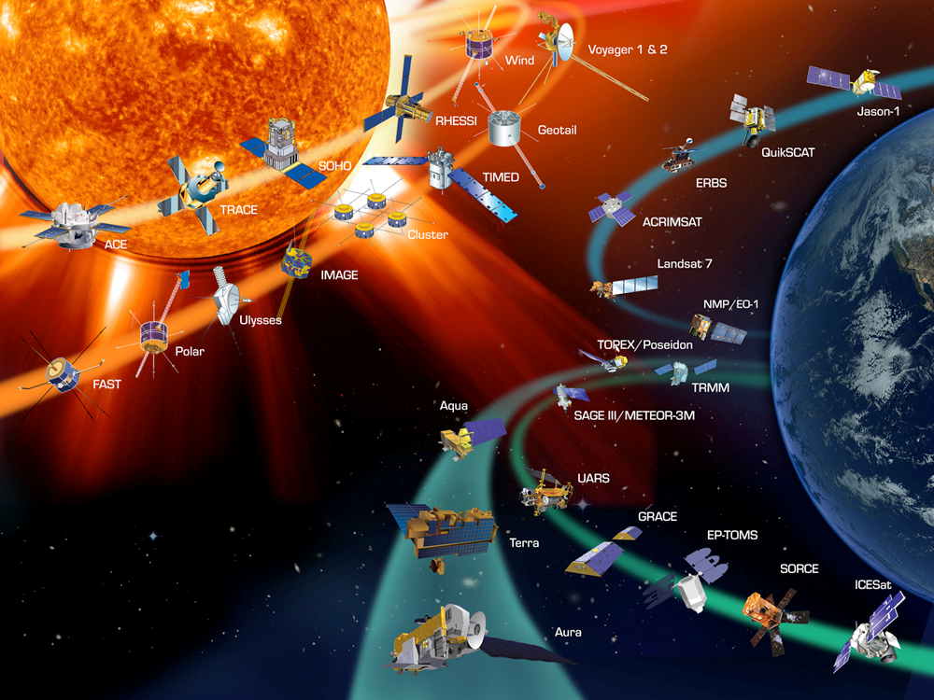
CHARGE Create a report of current and planned remote sensing capabilities used across the CMS, and their expected lifespans; then, identify missing parts or expected gaps to help with planning.

Slide 3

APPROACH Gather existing tables of relevant missions, instruments, and lifespans; update tables through user input from CMS Science Team.

Slide 4
https://docs.google.com/spreadsheet/ccc?key=0AtupLt5e_5rydHZ2U1dFZV9oNjZuY2NyOVZyLXc5d2c&usp=sharing#gid=0
Notes:
Tables for land, ocean, and atmosphere have been compiled and formatted.
A section for putting your name next to each mission/instrument if you use it, and space for a quick statement on how you use it are included.
There is a section for relevant missions/instruments that are not included.
Exclude in situ and airborne capabilities for now.
Tables have been imported into Google Docs.
Link/tables have been sent to JPL team (land, atmosphere, ocean), to George Hurtt, and to Diane Wickland for initial review.

Slide 5

Next Steps
Iterate with George Hurtt on changes/edits.
Send to larger CMS team.
Review edits/responses from CMS team.
Write report.

